Slide 1

2009 – 2010
Planning and Teamwork

Slide 2
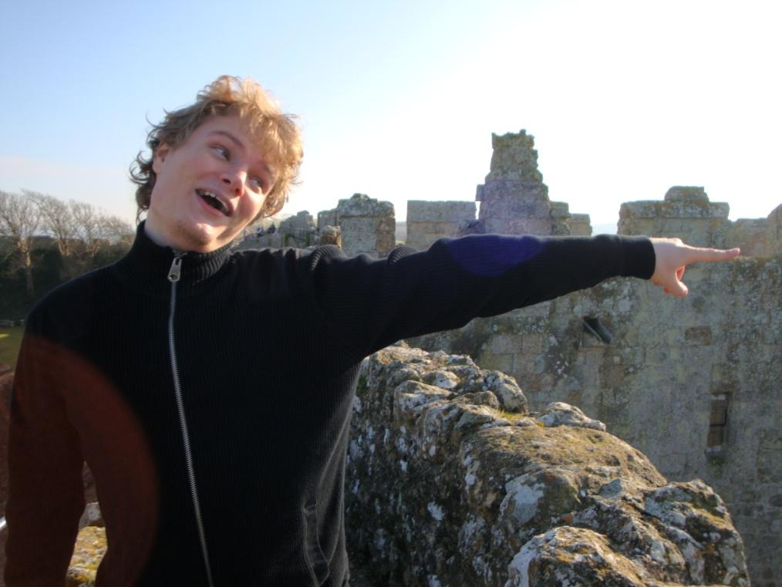
Presented By

Slide 3
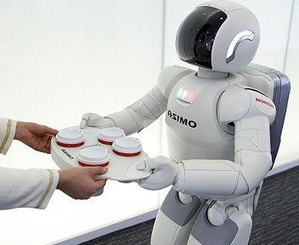
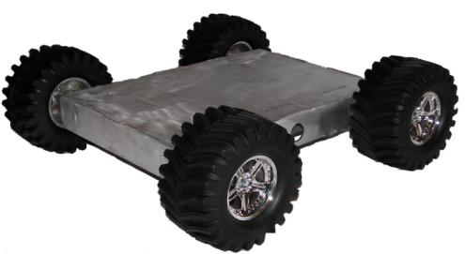
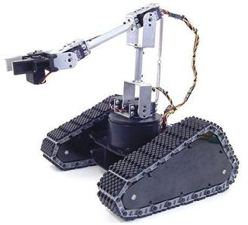
From MiniGame to Timeline
Picture of dolly built
KickStart
Competition
Christmas
A/AS-levels
Easter
I.
II.
III.
Robot moves
Robot has mechanisms to achieve goals
Robot uses a variety of sensors to understand and interact with its environment.
Notes:
[slide 1]
Hi my name is chris and i'm going to tell you about the electronics kit
The good news is that we don't expect you to have any previous experience with electronics,

Slide 4
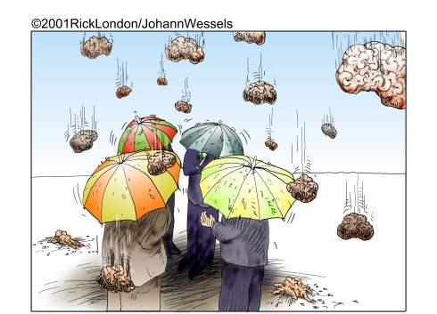
Getting Started

Slide 5
Getting Started
Brainstorming
  No idea is stupid...
  …but keep to the topic
“Aim for the moon, that way, even if you miss you'll still be amongst the stars.”
W. Clement Stone

Slide 6
Role-play
You are in a brainstorming session to decide the basic outline of your robot.
Give an example of an idea that you wouldn't say!
Any bad ideas?

Slide 7

Teamwork
Take roles
  Team coordinator
  Designers
  Builders
  Programmers
Take roles for tasks
  jam

Slide 8
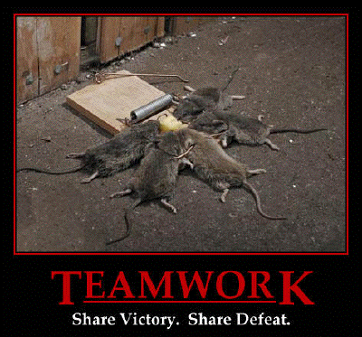
Team Work

Slide 9
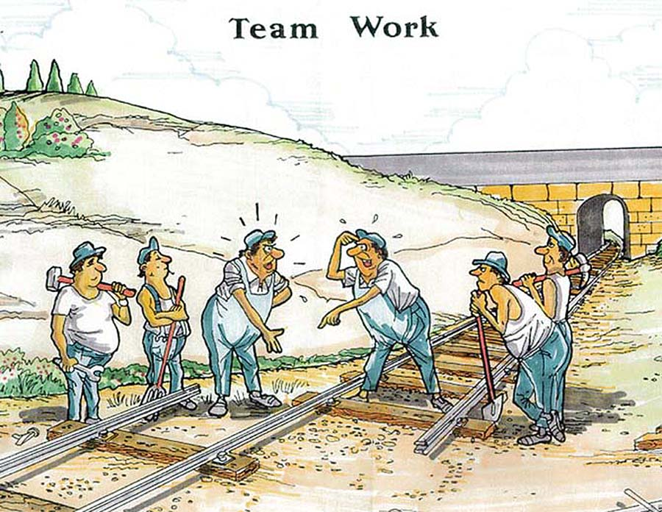
Team Work
Make sure you know what the rest of the team is doing!

Slide 10
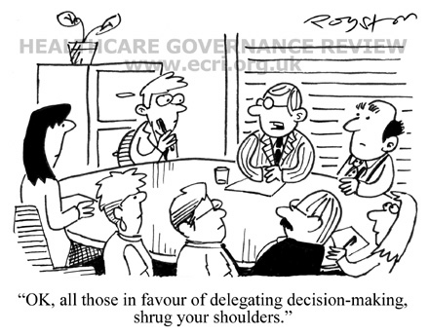
Team Work
Budget = £70
Don't be afraid to use it!
Budget = £70
Don't be afraid to use it!
Discuss => Decide => Do

Slide 11
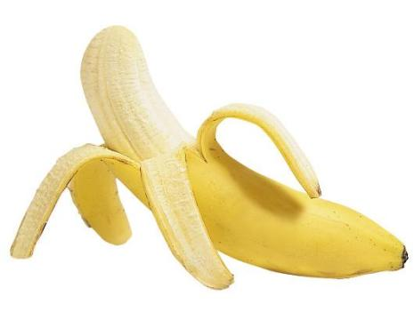
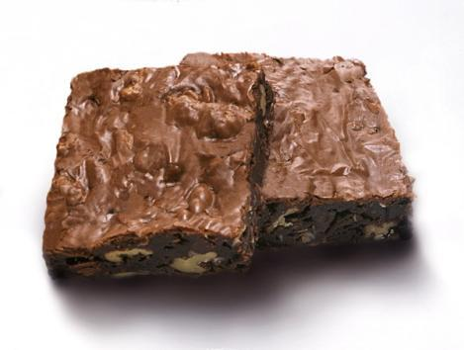
Role-play
You are approaching a problem: hunger
You come up with two solutions:
vs
How do you make the decision?

Slide 12




Building
Fail

Slide 13
Role-play
You came up with a great idea, which, according to your calculations works perfectly. Even your team mates agree.
Would you prototype it?

Slide 14

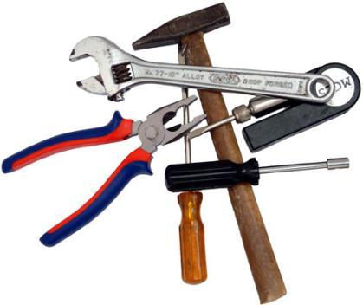


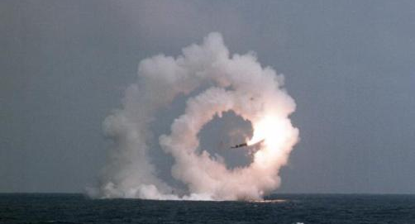
Prototyping
Try
Succeed
Fail

Slide 15
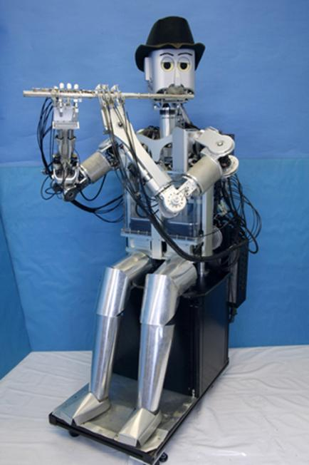
Chairman's Award
To promote initiative, good ideas and clever engineering
You gain points for reaching Milestones and for impressive (and working) designs
Share your success! Student Robotics blog, forum or even YouTube, twitter.
But strictly no plagiarism

Slide 16
Ask for Help
Use a online search engine
Use the Student Robotics website: studentrobotics.org
  Forums!
  Docs!
Ask your teacher
Ask someone from Student Robotics
Independent initiative
Share, search, succeed

Slide 17
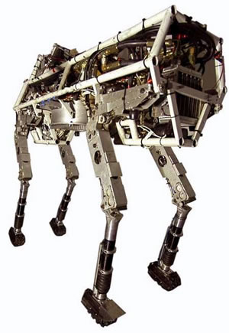
Summary
Aim for the Moon!
Make design decisions
Start simple
Prototype
Start programming early
Don't be afraid to ask for help and to share your experience

